Slide 1

Real Estate Price Prediction

Slide 2
REGRESSION MODEL OF REAL ESTATE DATASET
All About Dataset
Name of Dataset :- Real Estate Data
Variables:
X1 - Transaction Date (Date at which home is bought)
X2 - House Age (Age of house from when it was built)
X3 - Distance To The Nearest MRT Station
X4 - Number Of Convenience Stores
X5 - Latitude (Represents the geographical position of property)
X6 - Longitude (Represents the geographical position of property)
Y - House Price Of Unit Area
Source: https://www.kaggle.com/quantbruce/real-estate-price-prediction

Slide 3
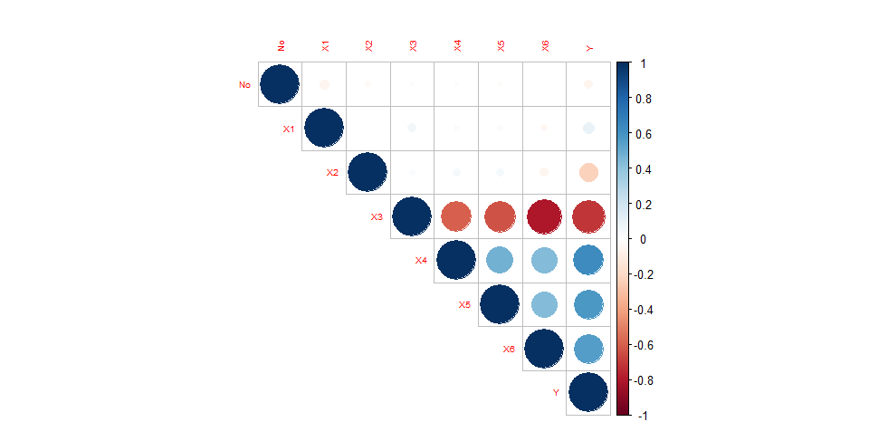
Correlation Plot Between Variables

Slide 4
Correlation Matrix
 | X1 | X2 | X3 | X4 | X5 | X6
X1 | 1 | -0.009308 | 0.054006 | 0.024994 | 0.024389 | -0.034151
X2 | -0.009308 | 1 | 0.025998 | 0.046235 | 0.046439 | -0.053359
X3 | 0.054006 | 0.025998 | 1 | -0.594963 | -0.630921 | -0.714931
X4 | 0.024994 | 0.046235 | -0.594963 | 1 | 0.472311 | 0.437196
X5 | 0.024389 | 0.046439 | -0.630921 | 0.472311 | 1 | 0.435171
X6 | -0.034151 | -0.053359 | -0.714931 | 0.437196 | 0.435171 | 1
From the correlation plot and correlation matrix we can clearly see that there is a correlation between X3 and X4 , X3 and X5 , X3 and X6 variables.

Slide 5
Multiple Linear Regression Model
Hypothesis:-
H₀: All β’s are insignificant.
H₁: At least one β is significant.
Significant variables:- (At 5% level of significance)
Model:
Y = βo + β₁X₁ + β₂X₂ + ………..+ β_{k}X_{k}
Y= -15960 + (5.135)*Transaction Date + (-0.2694)*House Age + (-0.00435)*Distance To The Nearest MRT Station + (1.136)*Number Of Convenience Stores + (226.9)* Latitude
Significant Variables | P - Value
Transaction Date | 0.00104
House Age | 1.04e-11
Distance To The Nearest MRT Station | 2e-16
Number Of Convenience Stores | 3.17e-09
Latitude | 4.36e-07

Slide 6
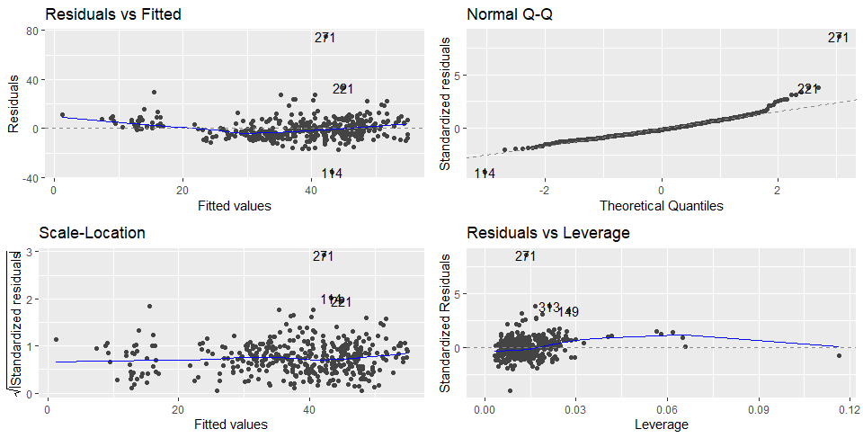
Assumptions Of Multiple Linear Regression Model

Slide 7
Multicollinearity
H_{0 :} There is no Multicollinearity between the variables.
H_{1:} There is Multicollinearity between the variables.
Since all the values are lies between 0 < VIF < 5,
Hence there is no multicollinearity among the regressor variables.
Autocorrelation
H_{0 :} Autocorrelation is absent.
H_{1:} Autocorrelation is present.
Since P-Value is not less than 0.05,
So at 5% l.o.s we do not reject our null hypothesis and conclude that Autocorrelation is absent.
X1 | X2 | X3 | X4 | X5
1.013834 | 1.013243 | 2.016855 | 1.611299 | 1.585635
D-W Statistics | 2.1541
P - Value | 0.128

Slide 8
Heteroscedasticity
H_{0 :} Data is homoscedastic (i.e Variance are equal)
H_{1:} Data is heteroscedastic (i.e Variance are not equal)
Since P-Value is not less than 0.05,
So at 5% l.o.s we do not reject our null hypothesis and conclude that the data is homoscedastic.
Multivariate Normality
H_{0 :} Errors are normally distributed.
H_{1:} Errors are not normally distributed.
Since P-Value is less than 0.05,
So at 5% l.o.s we reject our null hypothesis and conclude that the errors are normally distributed.
BP Test | 5.7624
P - Value | 0.33
K-S Normality Test | 0.078433
P - Value | 2.105e-06

Slide 9
Summary Of Regression Model
R Squared Value | 0.5823
Adjusted R Squared value | 0.5772
F - Statistics | 113.8
P - Value | 2.2e-16
From the R Squared value we can conclude the 58.23% variation is explained by our model. And also the P - Value is less than 0.05.
Note that:
If we add interaction term (i.e interaction between X3 and X4 , X3 and X5) and also remove outliers which is present in graphs there is a high chance of getting a good fit model as compared to this model.

Slide 10
Multiple Linear Regression Model
Hypothesis:-
H₀: All β’s are insignificant.
H₁: At least one β is significant.
Significant variables:- (At 5% level of significance)
Model:
Y = βo + β₁X₁ + β₂X₂ + ………..+ β_{k}X_{k}
Y= -2.0100 + (4.587)*Transaction Date + (-0.2888)*House Age + (2.920)*Distance To The Nearest MRT Station + (1.430)*Number Of Convenience Stores + (436.8)*Latitude + (-0.00120)*[Distance To The Nearest MRT Station: Number Of Convenience Stores] + (-0.1171)*[Distance To The Nearest MRT Station: Latitude]
Significant Variables | P - Value
X1 | 0.000299
X2 | 2e-16
X3 | 1.34e-05
X4 | 1.39e-14
X5 | 1.18e-15
X3:X4 | 2.52e-07
X3:X5 | 1.32e-05

Slide 11
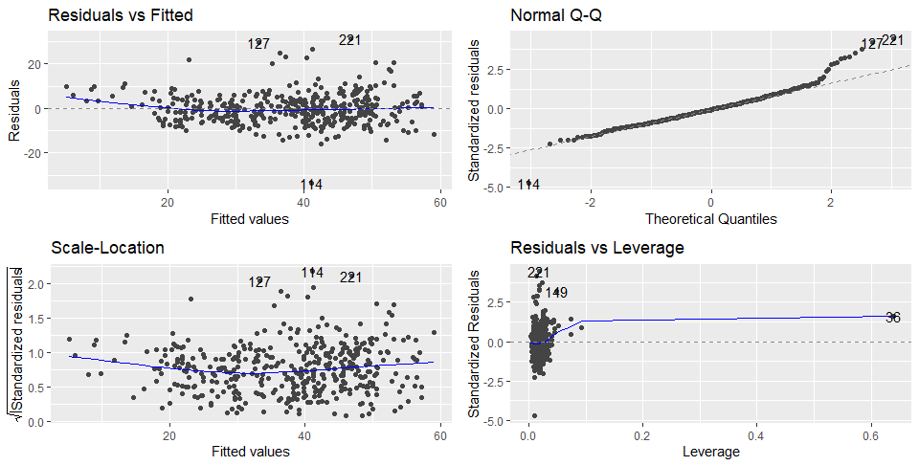
Graphical Representation

Slide 12
Summary Of The Model
R Squared Value | 0.7029
Adjusted R Squared value | 0.6978
F - Statistics | 135.9
P - Value | 2.2e-16
From the R Squared value we can conclude that 70.29% variation is explained by our model. Now our Multiple Linear Regression Model is good fit for the data.

Slide 13
Conclusion Of The Final Model
R-squared Value Of Our Final Model Is 70.29% .
From The Residual Vs Fitted Graph We Can See That The Estimated Error Curve Of Our Final Model Is Almost Converge To 0.
From The QQ-plot We Can See That The Our Model Behaves Like Normal Except For The Tail Parts.
Data Is Homoscedastic.

Slide 14
Thank You !!

